Slide 1

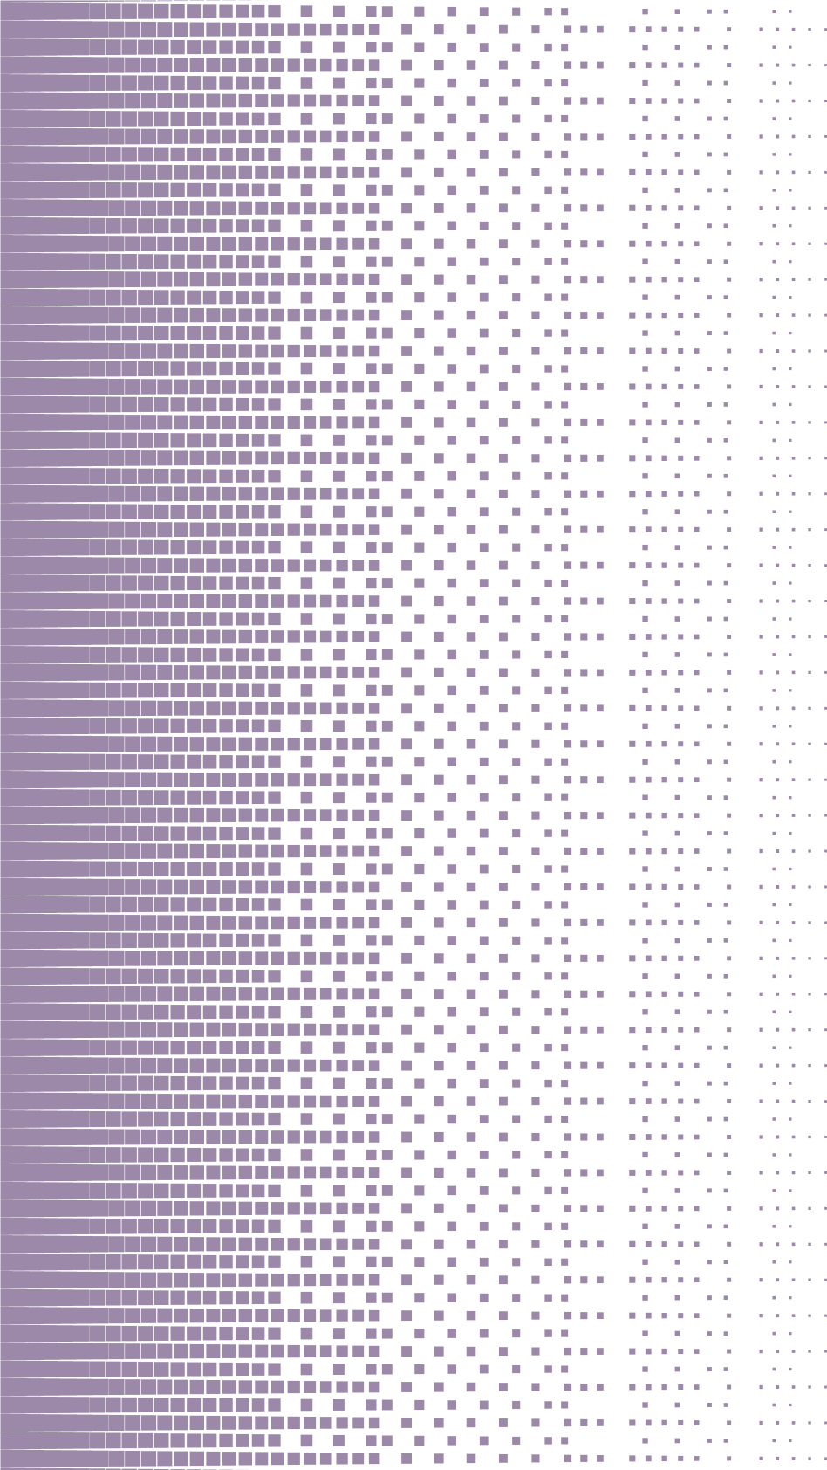
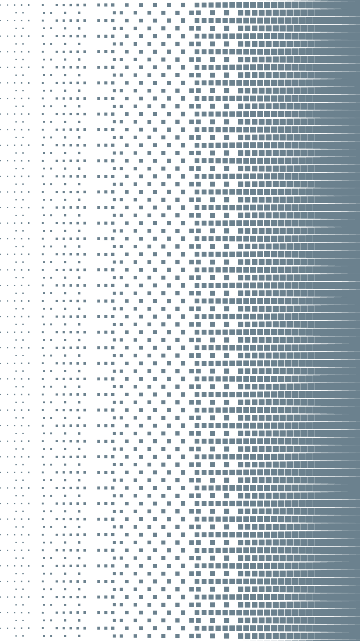
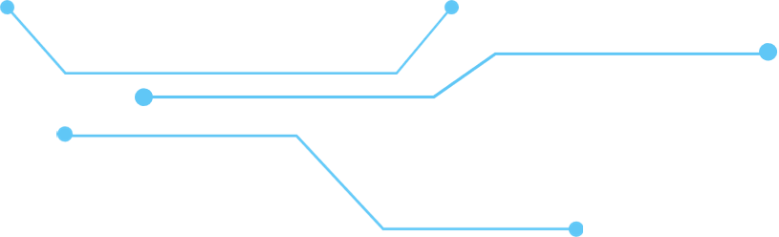
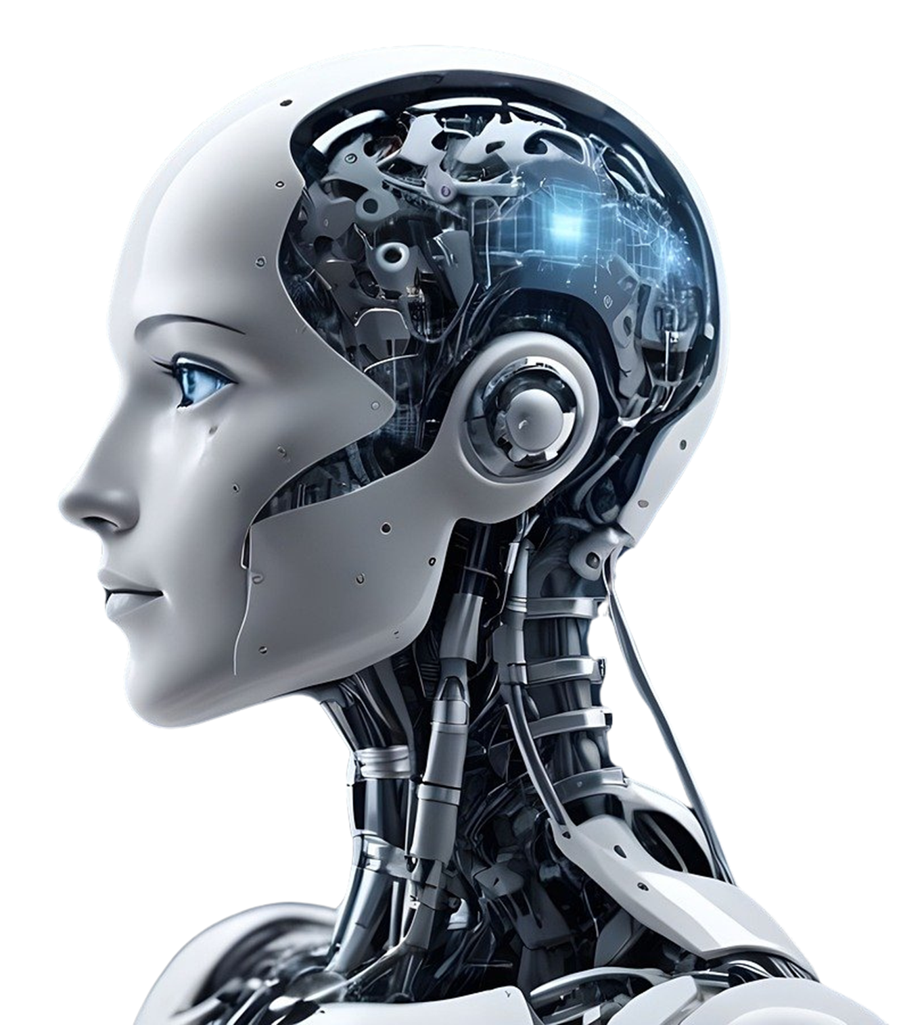

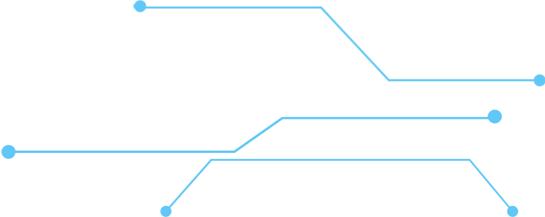
FERTILIZER RECOMMENDATION USING
MACHINE LEARNING

Slide 2
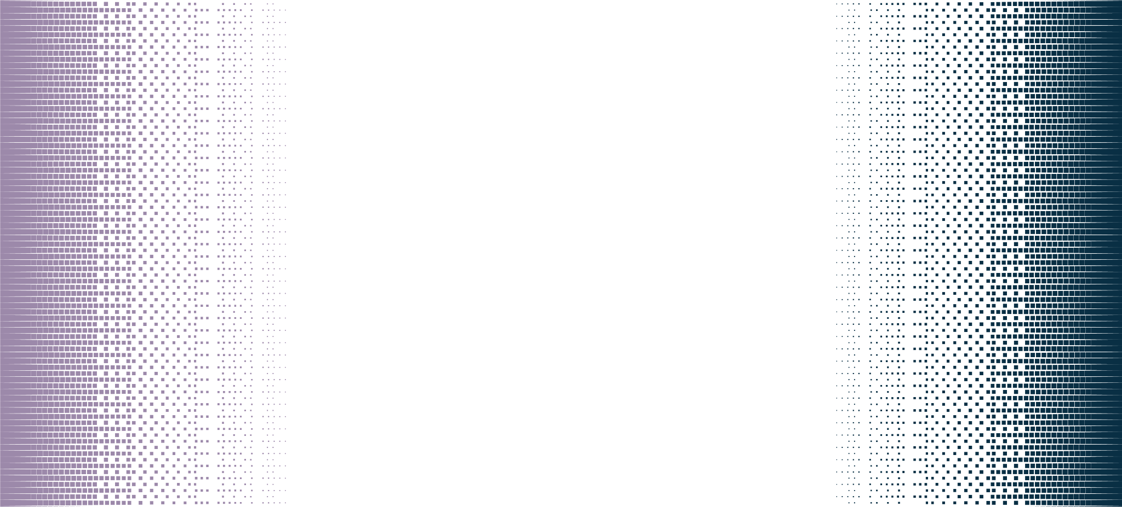


TEAM INFORMATION
PRESENTED BY:
MD. Yousuf Ibna Alam Joy
ID: 221002481
Student
Dept. of CSE
GREEN UNIVERSITY OF BANGLADESH
PRESENTED TO:
Abdullah Al Farhad
Lecturer
Dept. of CSE
GREEN UNIVERSITY OF BANGLADESH

Slide 3

TABLE OF CONTENTS
INTRODUCTION
PROBLEM STATEMENT
MOTIVATION
KEY FEATURES
HOW IT WORKS
EXPECTED OUTCOMES
TOOLS & TECHNOLOGIES
FUTURE ROADMAP
CONCLUSION
1

Slide 4




INTRODUCTION
Fertilizers are essential for crop yield but must be used correctly.
Overuse or wrong selection harms crops and soil.
Aim: Use AI to provide precise fertilizer recommendations based on soil and weather data.
2

Slide 5


Problem Statement
Wrong fertilizer = ❌ low yield, ❌ soil degradation, ❌ extra cost.
No smart system currently personalizes fertilizer advice by soil and weather conditions.
We propose a solution using a hybrid AI model.
Challenges in traditional farming: Over/underuse of fertilizers, cost inefficiency, environmental harm.
Lack of personalized recommendations.
3

Slide 6
Motivation
Agriculture = backbone of many economies.
AI can:
Boost yield 🌾
Save cost 💰
Protect the environment 🌱
Empowering farmers through data-driven insights.
4

Slide 7
Key Features
Farmer Portal: Track fields, recommendations
Premium Services: Weather forecasting, irrigation planning.
Resources: Guides, research papers
5

Slide 8
How it works
Data Input: Soil pH, NPK levels, weather (show form screenshot).
ML Model: Trained on crop/soil datasets.
Output: Fertilizer mix (e.g., "Urea + MOP" for Rice).
6

Slide 9
Tools & Technologies
Frontend: HTML/CSS, JavaScript.
Backend: Python (Flask/Django).
ML: Scikit-learn, XGBoost.
Data: Soil/crop datasets.
7

Slide 10
Expected Outcomes
Accurate fertilizer recommendations.
Lower cost & higher crop yield.
Environmentally friendly (less waste).
Can scale across different regions.
8

Slide 11

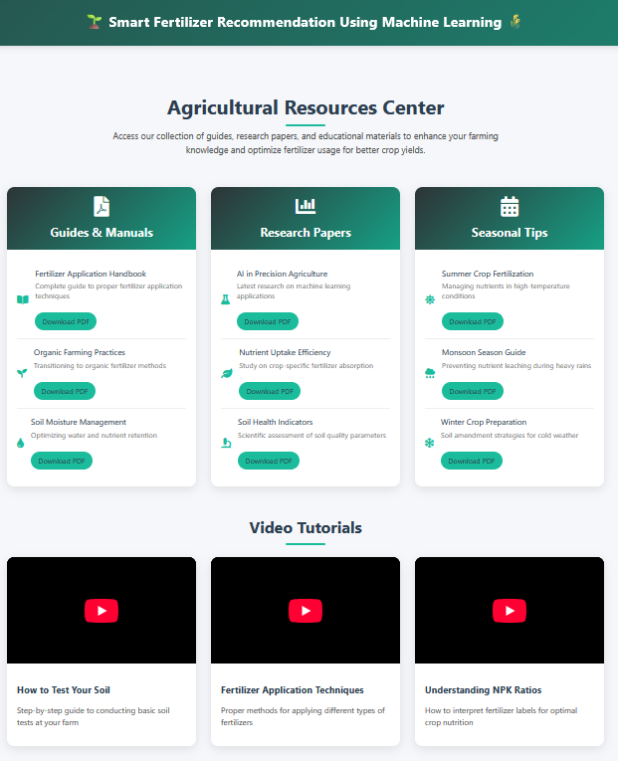
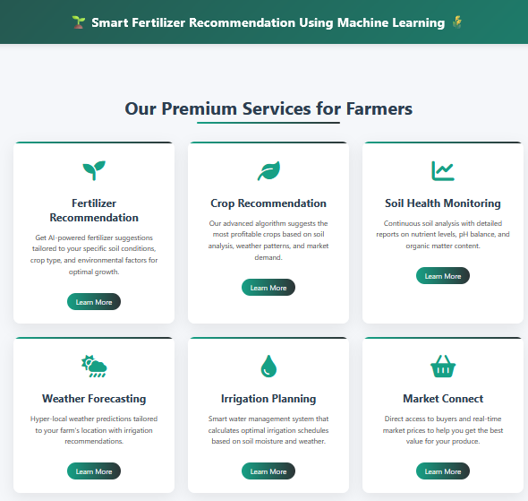
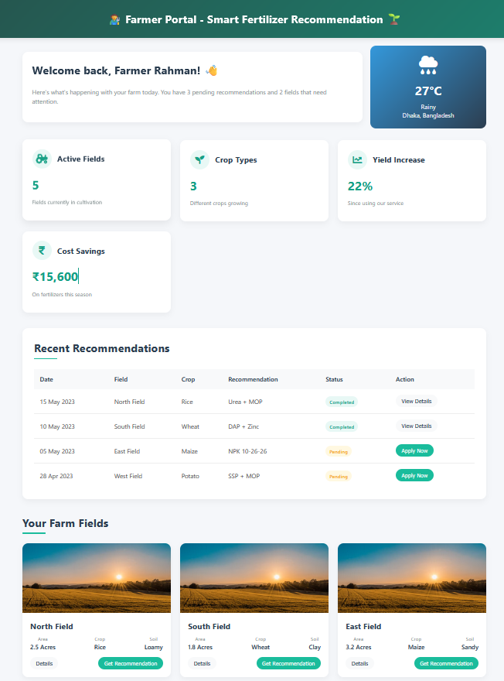
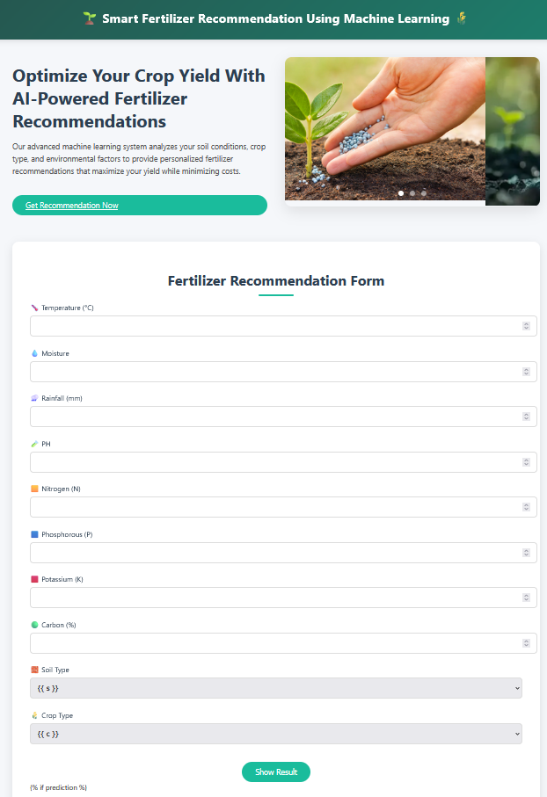
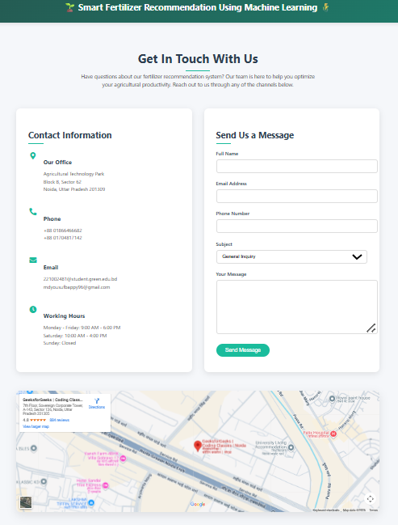
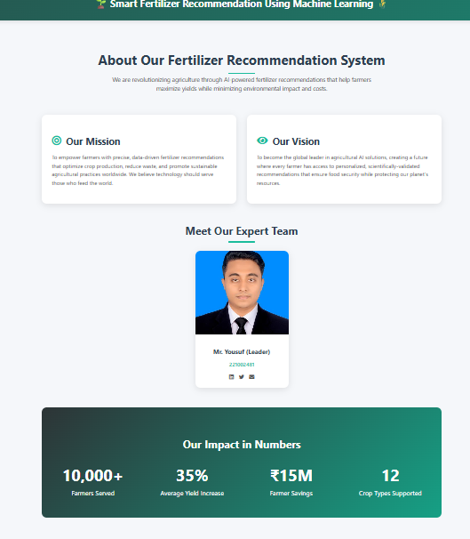
MY PROJECT SAMPLE
9

Slide 12
Future Roadmap
Mobile app development.
Expand crop/region support.
IoT soil sensors integration.
10

Slide 13
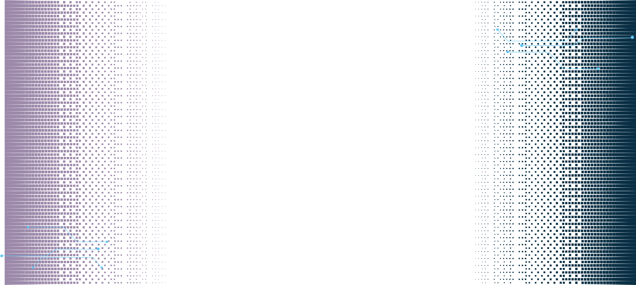
Conclusion
In closing, our project bridges the gap between traditional farming and cutting-edge AI, offering a scalable solution to food security and environmental sustainability. By empowering farmers with data-driven decisions, we’re not just improving yields—we’re cultivating a smarter, greener future for agriculture
11

Slide 14
Thank You….
12

